Slide 1
CREDIT CARD ANALYSIS for strategy team in banking sector based on customer needs and market research

Slide 2





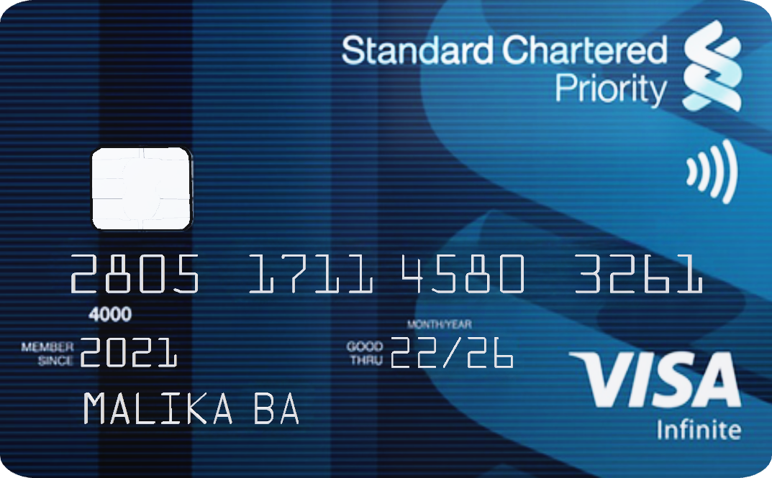
In May 2022, the overall credit card spend reached its highest-ever number of INR 1.13 lakh crore
80% concentration of the credit card base is in the top-six issuers in the country
Credit card issuance increased by 15% during FY22
About Industry
The no. of credit cards crossed 78 million in July 2022
Source
20% CAGR in the last 5 years

Slide 3
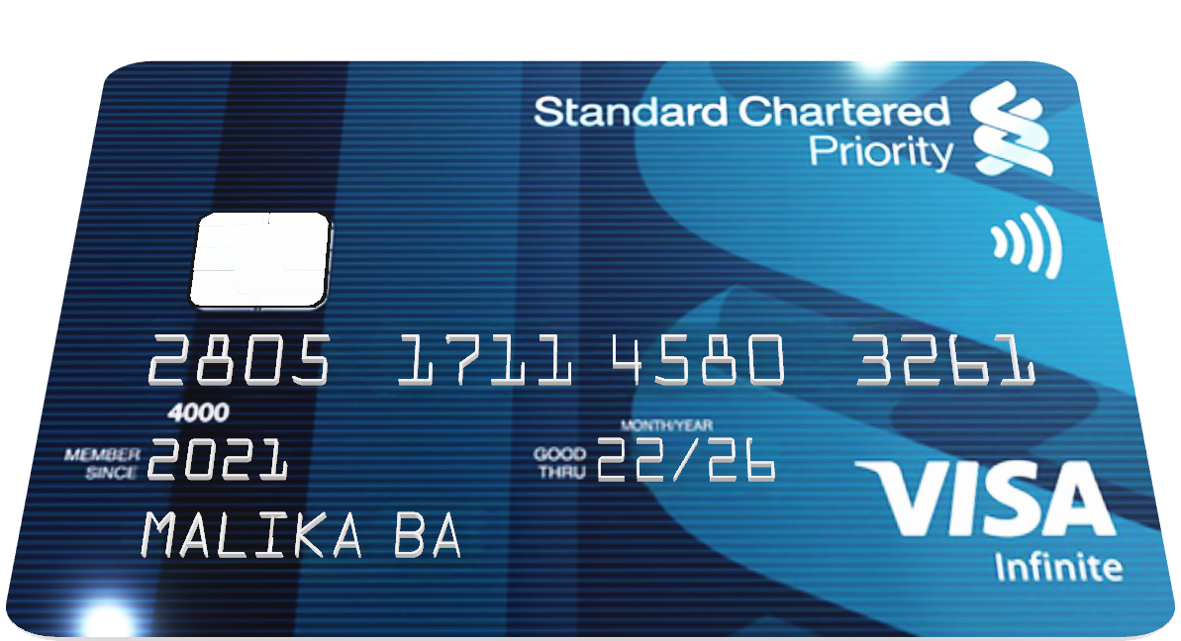
About Company
Mitron Bank Hyderabad
Mitron Bank is a legacy financial institution headquartered in Hyderabad. They want to introduce a new line of credit cards, aiming to broaden its product offerings and reach in the financial market.
Here I will be presenting my finding as a Data Analyst to address following expectation of our stakeholders with the help of sample datasets provided by Strategy Team of company:
Customer Analysis (Demographics, Income, Occupation….etc.)
Customer Spend Analysis (Where they spend? How they prefer Spending? Variation of Spending?)
Classification of People as a potential customer using KPIs (%Utilization of Income, Average Income)
Strategic Suggestion on Features of Credit Card (To improve and support market entry)

Slide 4



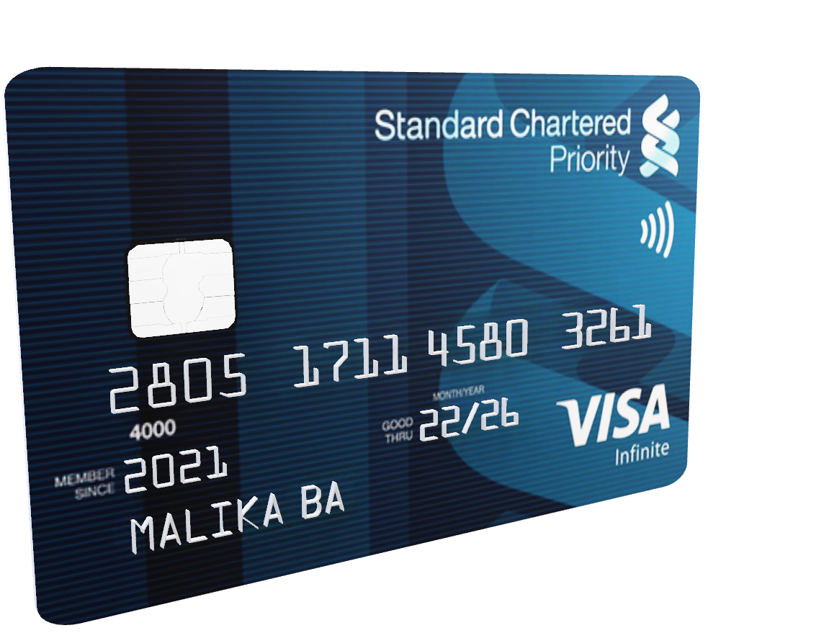
WHO ARE OUR CUSTOMERS?
- Demographics Analysis
- Income and Occupation Analysis
- In this stage we will focus on uncovering the salient features of our customers
WHAT ARE THEIR SPENDING ACTIONS?
- Spending analysis on multiple parameters
- Aligning the analysis with our KPIs
- In this stage we will drill down into needs of our customers to provide them viable product
HOW CAN WE CAPTURE OUR TARGET AUDIENCE?
- Summarizing our findings
- Performing Secondary Research
- In this step we will explore the market and tailor our product with general behaviours of customer

Slide 5
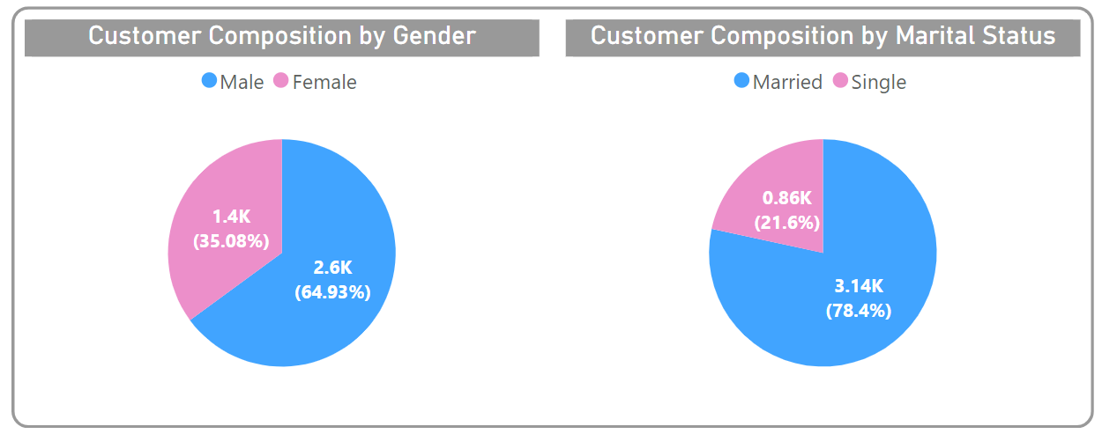
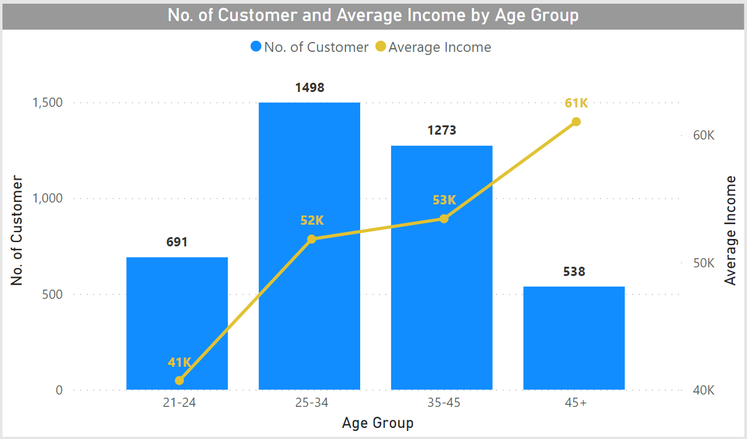
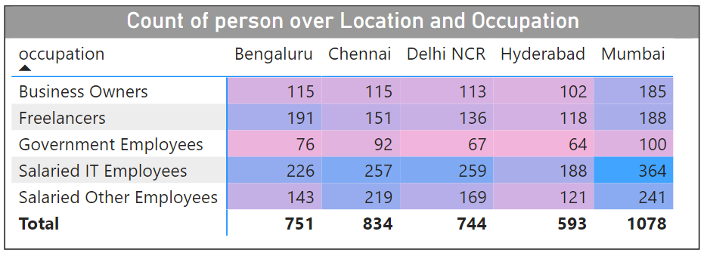
Following are the major demographics key takeaway after analyzing data of 4000 people
64% are Males and 36% are Females
78% are Married and 22% are Singles
70% people belong to age group 25-34 and 35-44
We have highest number of people living in Mumbai followed by Chennai, Bengaluru, Delhi NCR and at last Hyderabad
DEMOGRAPHICS

Slide 6
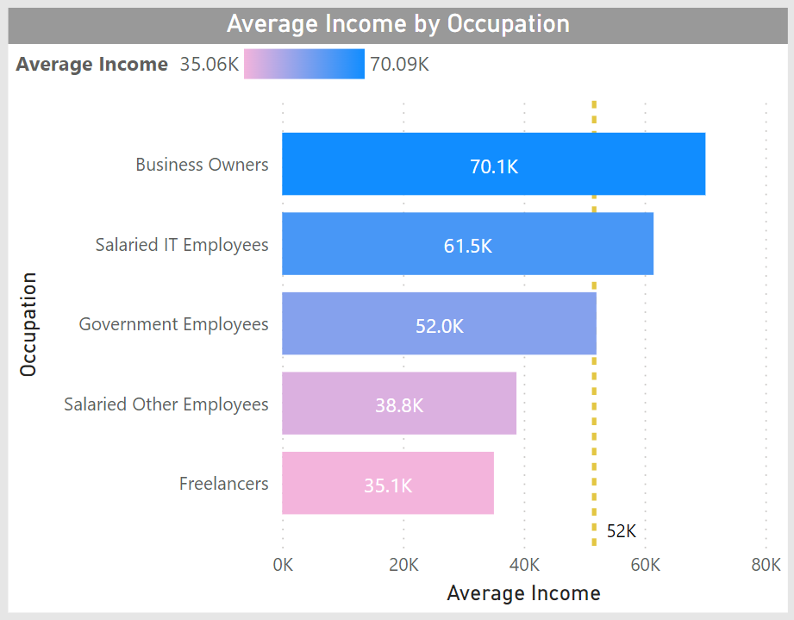
Following are the major key takeaway after analyzing data of 4000 people
Occupation Business Owners have the highest average income followed by Salaried IT employees while Freelancers have the least average income levels
People from age group above 45 have least count but they have highest average income, followed by age group 25-34 and 35-45 while age group 25-34 have the least average income
Income and Occupation
Average Income of total population is 51,657
Average Income Increases as we ascend in age-group even if the count decreases

Slide 7
WHO ARE OUR CUSTOMERS?
- Demographics Analysis
- Income and Occupation Analysis
- In this stage we will focus on uncovering the salient features of our customers
WHAT ARE THEIR SPENDING ACTIONS?
- Spending analysis on multiple parameters
- Aligning the analysis with our KPIs
- In this stage we will drill down into needs of our customers to provide them viable product
HOW CAN WE CAPTURE OUR TARGET AUDIENCE?
- Summarizing our findings
- Performing Secondary Research
- In this step we will explore the market and tailor our product with general behaviours of customer

Slide 8
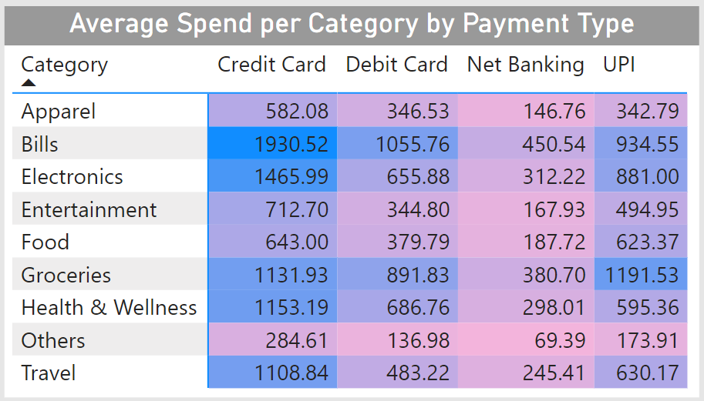
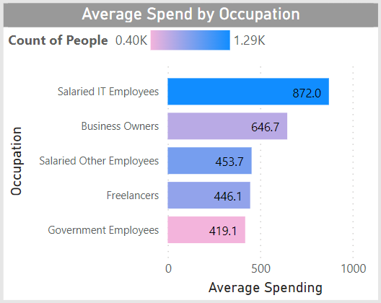
Following are the key takeaways from spending analysis
Based on occupation Salaried IT Employees have the highest average spend followed by Business Owners while Government Employees have least average spend value
In case of Credit Card, people have the highest average spend amount in Bills, Electronics, Groceries category followed by Health & Wellness, Travel. Another popular type of transaction is UPI
Spending Analysis
Color variation indicates the concentration of customers in a given occupation
Segregation of average spending amount by Category and Mode of Payment
(Values are indicating average spend amount)

Slide 9
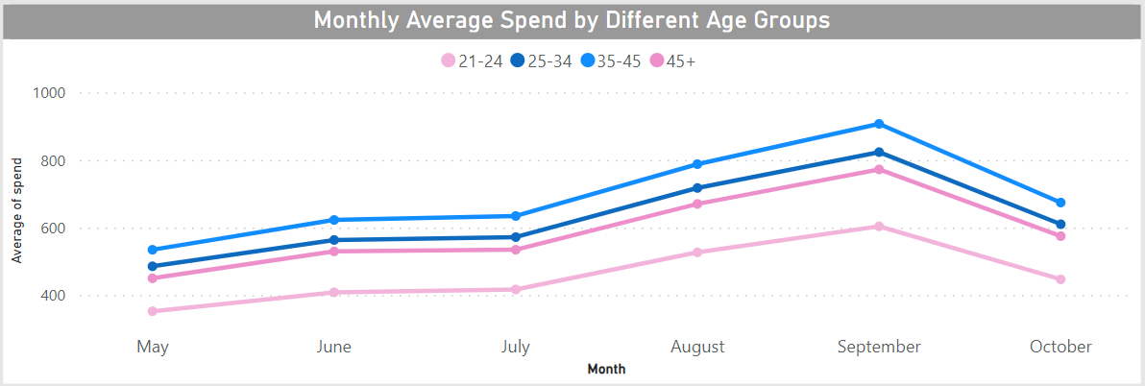
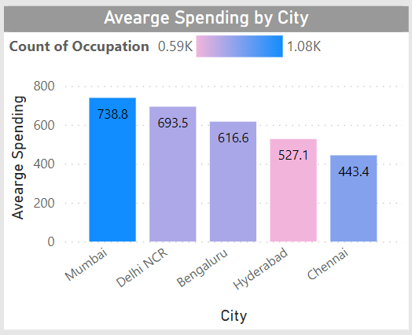
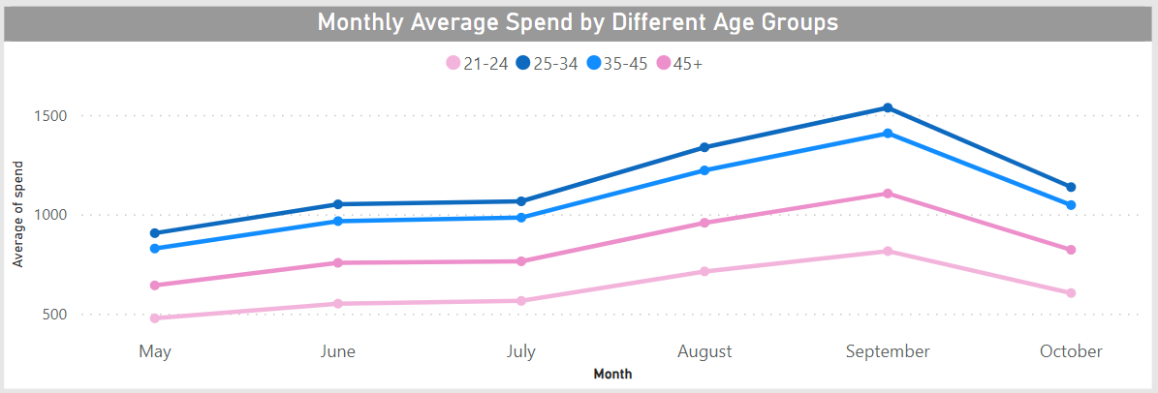
Following are the key takeaways from spending analysis
Based on City Mumbai have the highest average spend amount followed by Delhi NCR, Bengaluru while Chennai has the least average spend amount
People love to spend more in the month of August and September. Alternatively, people in age group 35-45 have a higher average spend amount followed by 25-34. Pattern inverts in case of Credit Card Payment where 25-34 surpasses 35-45
Spending Analysis
Color variation indicates the concentration of customers
Credit Card Payment

Slide 10

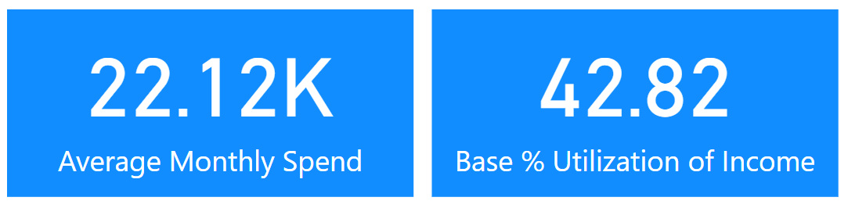
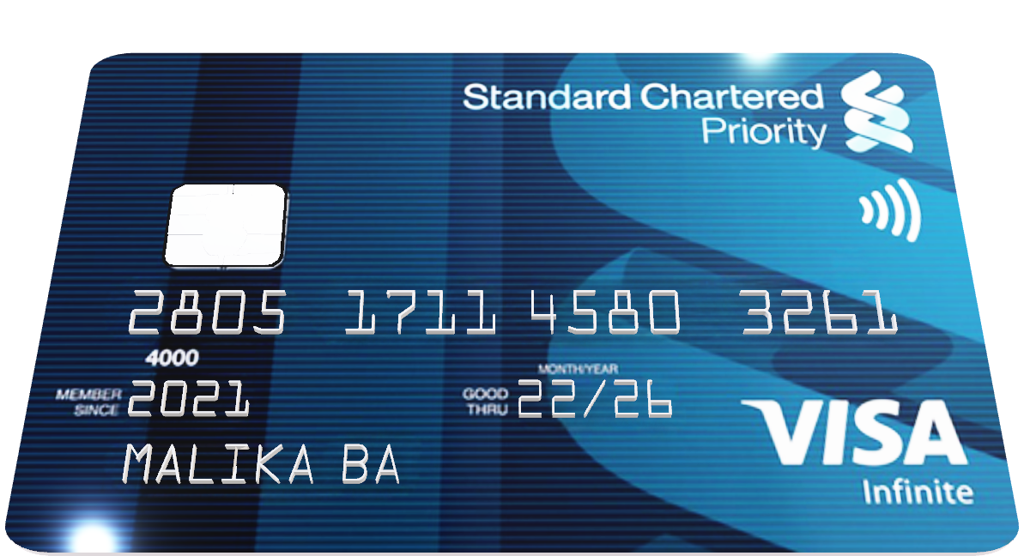
We will be using % Utilization of Income as our KPI for finding the right target audience. Additionally we can combine it with Average Monthly Spending to derive better results
% Utilization of Income = Average Monthly Spend / Average Monthly Income
Key Performance Indicator
Complimentary Indicator
If Original Value > 42.82
Then Target Audience
If Original Value < 42.82
Then Not Target Audience but Potential Consumers

Slide 11
WHO ARE OUR CUSTOMERS?
- Demographics Analysis
- Income and Occupation Analysis
- In this stage we will focus on uncovering the salient features of our customers
WHAT ARE THEIR SPENDING ACTIONS?
- Spending analysis on multiple parameters
- Aligning the analysis with our KPIs
- In this stage we will drill down into needs of our customers to provide them viable product
HOW CAN WE CAPTURE OUR TARGET AUDIENCE?
- Summarizing our findings
- Performing Secondary Research
- In this step we will explore the market and tailor our product with general behaviours of customer

Slide 12
Interesting insights when compared using KPIs
Our target audience is Salaried IT Employees (High Income and High % Utilization) and Freelancers (Low Income but High % Utilization)
Our Potential Target Audience can be Salaried Other Employes (Medium Income and Just below % Utilization)
Our Potential Audience can be Business Owners (Highest Income Low % Utilization) and Government Employees
Target Audience by Occupation
Occupation | Average Spend (Base 22.12K) | Average Monthly Income | % Utilization of Income (Base 42.82) | Unique Findings | Final Suggestion
Salaried IT Employees | 31.39K | 61.5K | 51.04 | 2nd Highest Average Income Per Month | Target Audience
Freelancers | 16.06 | 35.1K | 45.80 | Lowest Monthly Income | Target Audience
Salaried Other Employees | 16.33K | 38.8K | 42.10 | Just near % Utilization | Potential Target Audience
Business Owners | 23.28K | 70.1K | 33.22 | Highest Average Income but very low % Utilization | Potential Target Audience
Government Employees | 15.09K | 52.0K | 29.00 | Least Average Spend | Potential Audience

Slide 13
Interesting insights when compared using KPIs
Based on City our target audience is accumulated in Mumbai, Delhi NCR and Bengaluru while we need to drop Hyderabad and Chennai
Based on age group our target audience belongs to age group of 25-34 and 35-45 whereas 21-24 can be our potential target audience and 45+ are not near our metrics
Target Audience By
Age Group and City
City | Average Spend (Base 22.12K) | % Utilization of Income (Base 42.82) | Final Suggestion
Mumbai | 26.60K | 51.43 | Target Audience
Delhi NCR | 24.97K | 48.03 | Target Audience
Bengaluru | 22.20K | 43.46 | Target Audience
Hyderabad | 18.98K | 36.25 | Potential Audience
Chennai | 15.96K | 31.10 | Potential Audience
Age Group | Average Spend (Base 22.12K) | % Utilization of Income (Base 42.82) | Final Suggestion
35-45 | 24.96K | 46.72 | Target Audience
25-34 | 22.63K | 43.66 | Target Audience
21-24 | 16.53K | 40.59 | Potential Target Audience
45+ | 21.18K | 34.70 | Potential Audience

Slide 14

RECOMMENDATIONS FOR STRATEGY TEAM
TARGET AUDIENCE
POTENTIAL TARGET AUDIENCE
People of age group 25-45 who live in Mumbai, Delhi NCR, Bengaluru and work as IT Professionals or Freelancers
People of age group 21-24
Other Salaried Employees
Business Owners (they possess the highest average income)
SPENDING BEHAVIOR
FEATURES THAT ENABLE HIGHER ADOPTION RATE AMONG USERS
Following are the places where people are more comfortable in using credit card as a mode of payment
Bills
Electronics
Groceries
Health & Wellness
Travel
One-Time Bonuses
Cashbacks
Reward Points
Safety and Security Policies
Insurance Benefits
Credit Score
Financing Benefits
Source 1
Source 2

